Slide 1
cross modality synthesis (MRI to CT)
Yu Zhao, zhaoyu.hust@gmail.com

Slide 2
Background
Radiotherapy treatment planning:
Target delineation, treatment response assessment, adaptive therapies, etc.
MR images are necessary: superior soft-tissue contrast, etc. Missing: electron density info, provided by CT images ➔ CT-MRI coregistration: 1. misalignment; 2. workflow, patients and costs pressure.
MRI-only simulation workflow: providing both info on tumor volume and location and electron density information.

Slide 3
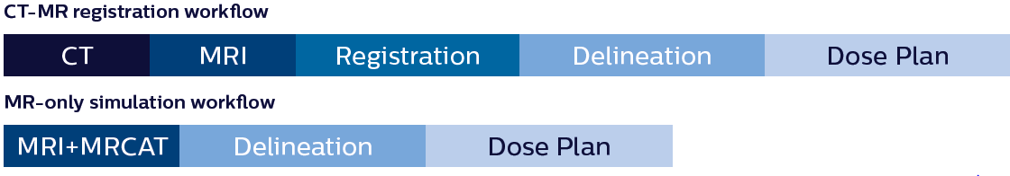
Background
CT-MR registration VS MR-only simulation
Notes:
MRCAT (Magnetic Resonance for Calculating ATtenuation)

Slide 4
Background
MRI images: in-phase (IP), out-of-phase (OOP): sequences correspond to paired MRI gradient echo (GRE) sequences obtained with the same repetition time (TR) but with two different echo time (TE)values.
The main application of the IP-OOP sequences is to identify pathological (microsopic) fat content of tissues in the abdomen by showing signal intensities drop on the OOP images compared to the IP images.

Slide 5
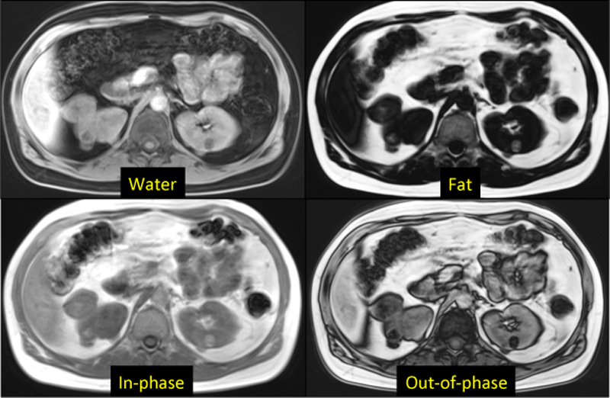
Background
fat only = in-phase - opposed phase
water only = in-phase + opposed phase

Slide 6
Methods
1. Style Transfer
2. Image Analogy
3. Deep Learning Nets

Slide 7
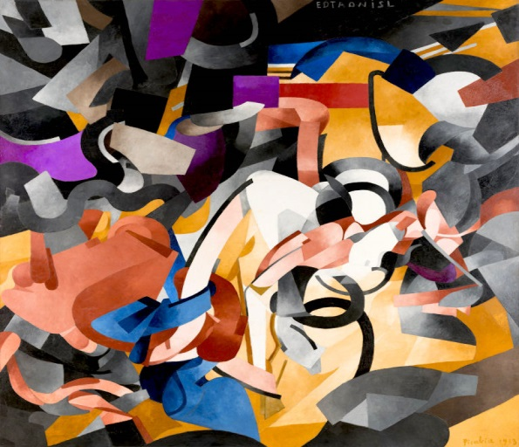
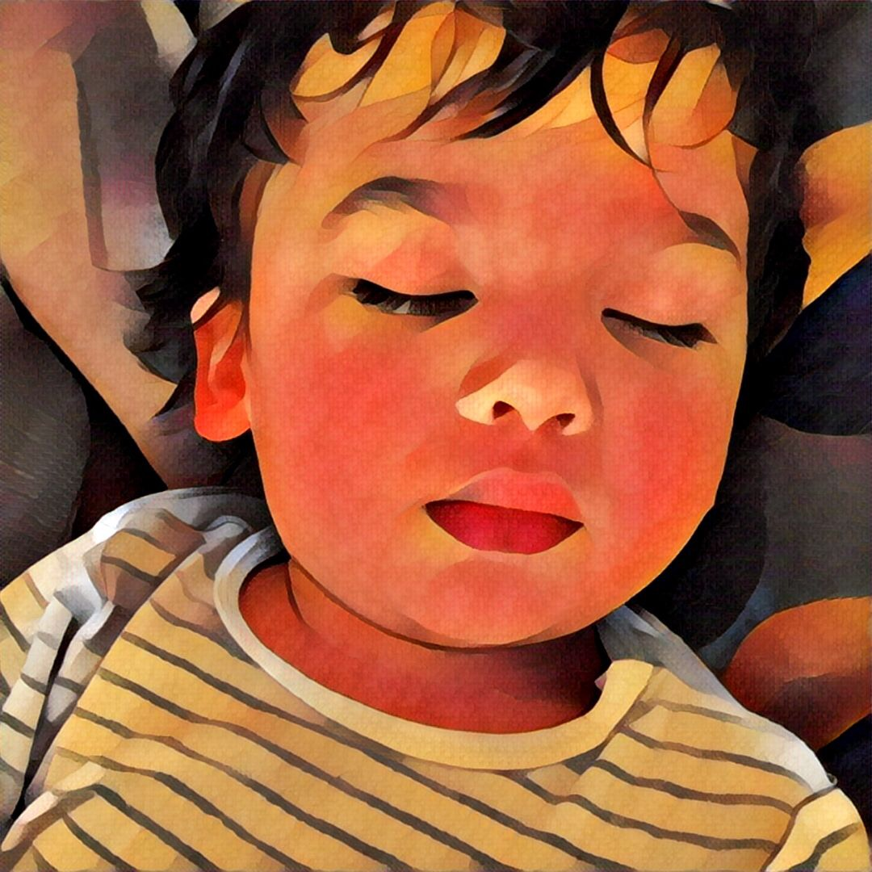
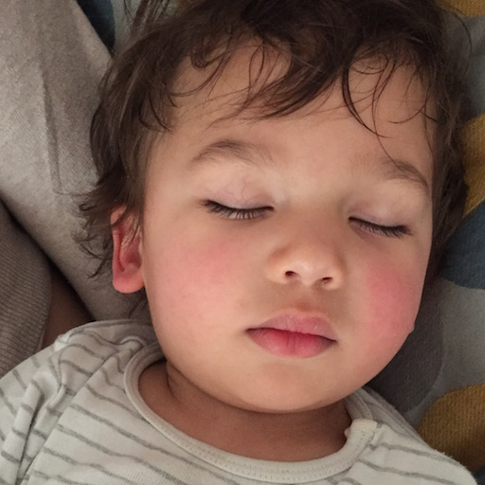
1. Style Transfer
Style
Synthetic
Content

Slide 8
1. Style Transfer
A Neural Algorithm of Artistic Style
Leon A. Gatys, Alexander S. Ecker, Matthias Bethge
1). A new way to visualize feature. Use gradient decent to update the image till it generate similar feature response.
2). content reconstruction
3). style reconstruction

Slide 9
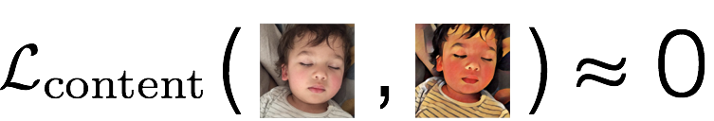
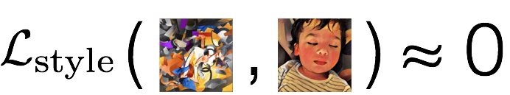
1. Style Transfer
A schematic of the content loss.
A schematic of the style loss.

Slide 10
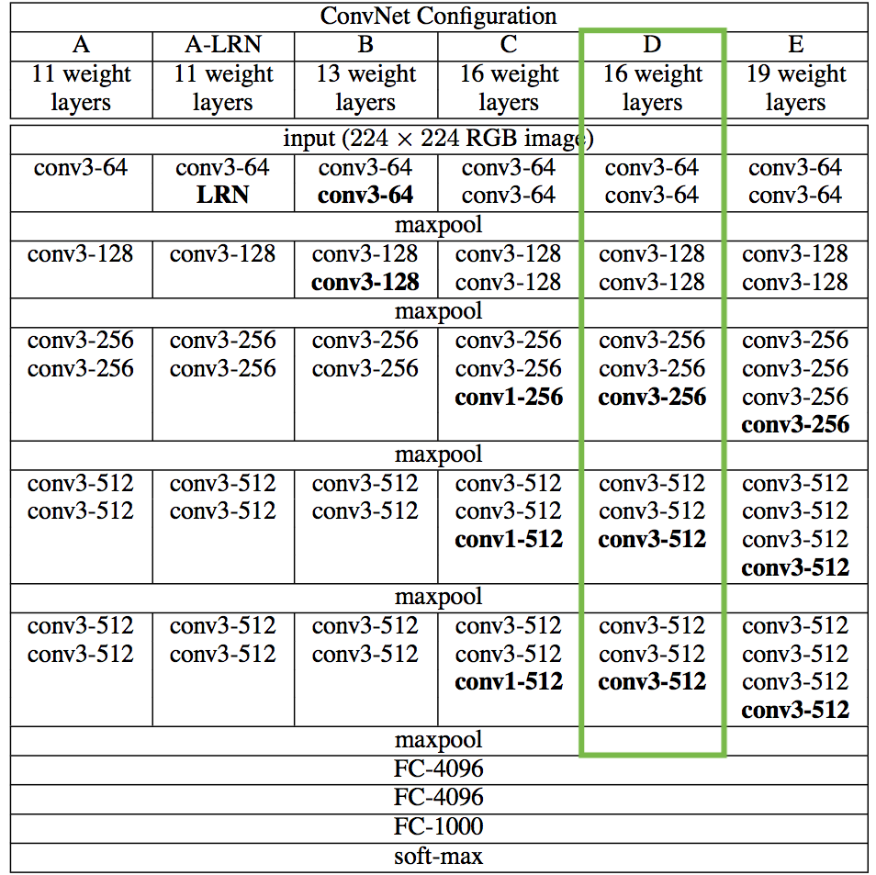
1. Style Transfer
Feature extraction nets for losses

Slide 11
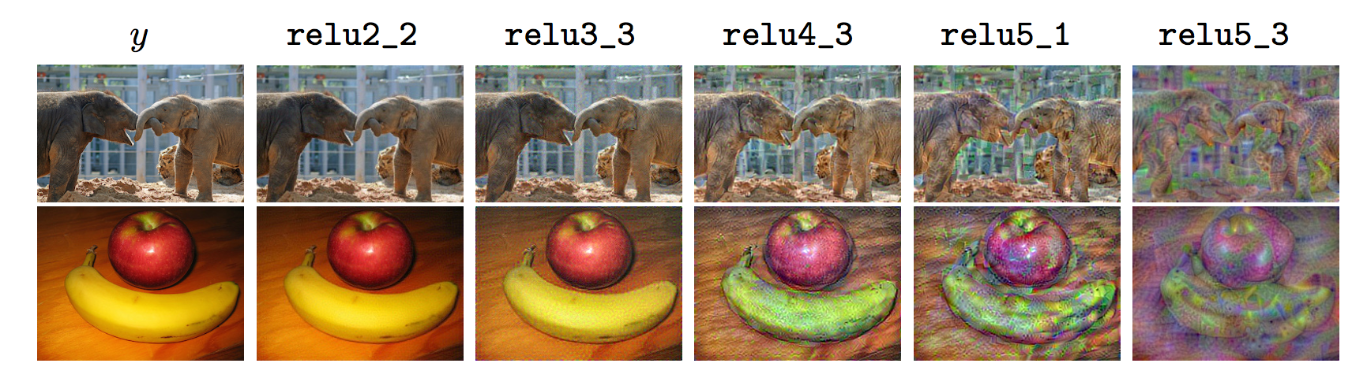
1. Style Transfer
Feature visualization
Content features at different level

Slide 12
Content loss
The content loss is the (scaled, squared) Euclidean distance between feature representations of the content and combination images.
draw the content feature from block2_conv2 ➔ structural detail

Slide 13
Style loss
Gram matrix
The terms of this matrix are proportional to the covariances of corresponding sets of features, and thus captures information about which features tend to activate together. By only capturing these aggregate statistics across the image, they are blind to the specific arrangement of objects inside the image. This is what allows them to capture information about style independent of content.
The style loss is then the (scaled, squared) Frobenius norm of the difference between the Gram matrices of the style and combination images.

Slide 14
Total loss
Total loss
= content loss + style loss + variation loss
(a regularization term that encourages spatial smoothness)

Slide 15
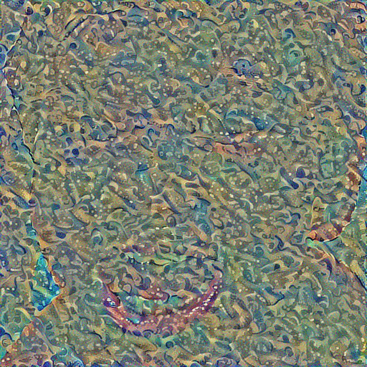
Regression
Gradient Decent

Slide 16
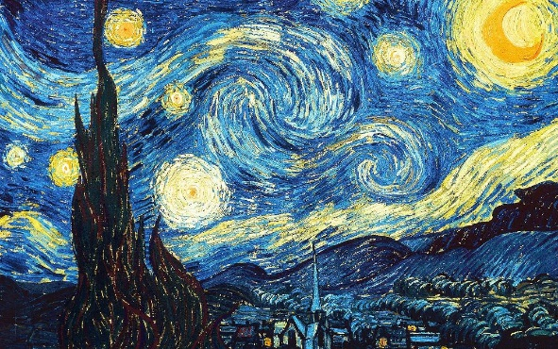
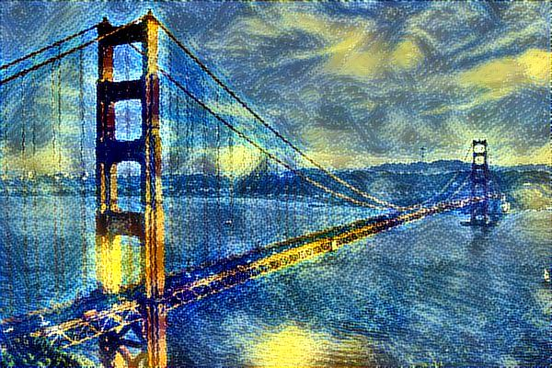
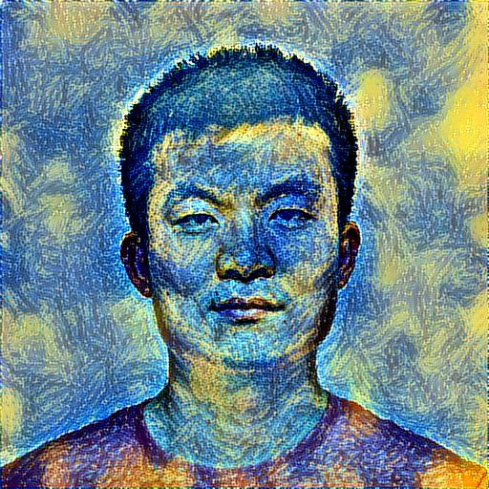
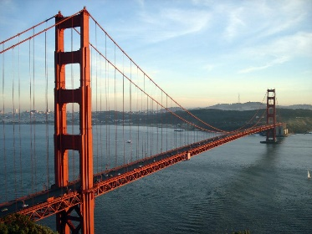

Reproduction results
Style Image
Content Images

Slide 17
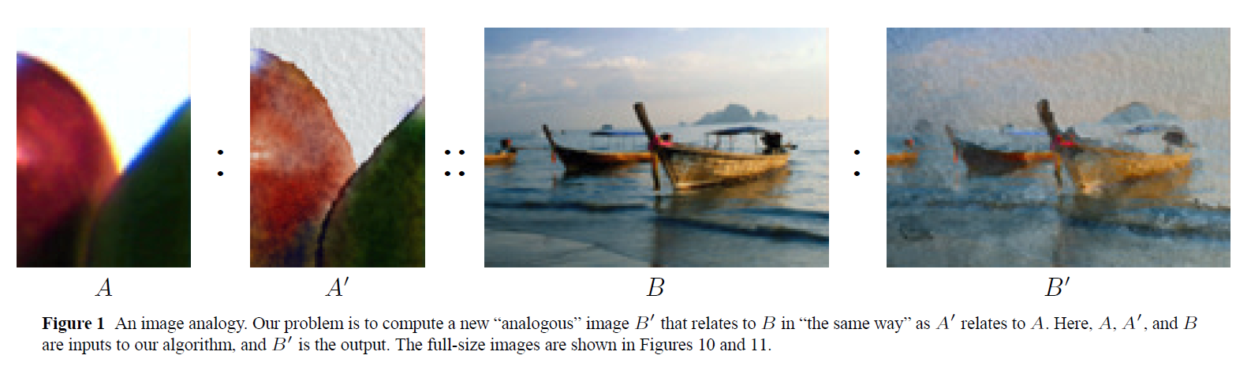
2. Using Image Analogies:
http://www.mrl.nyu.edu/publications/image-analogies/analogies-fullres.pdf

Slide 18
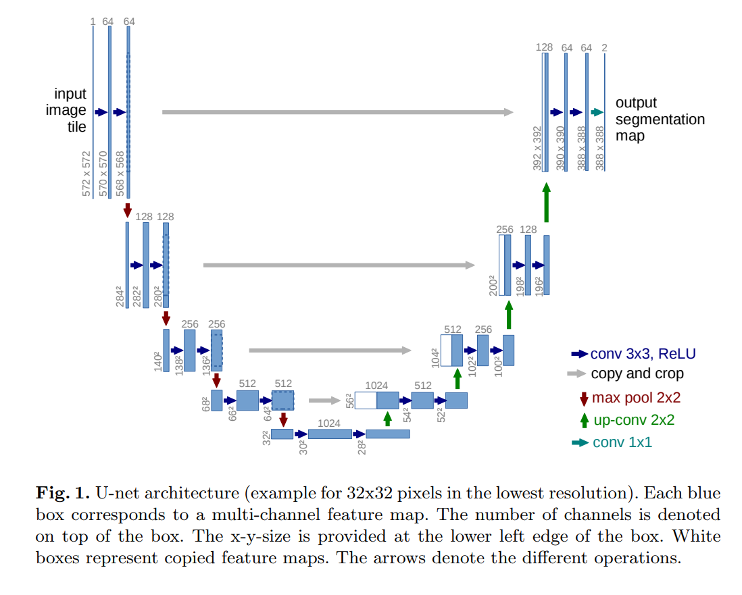
3. Deep Learning Nets
U-Net: Convolutional Networks for Biomedical Image Segmentation

Slide 19
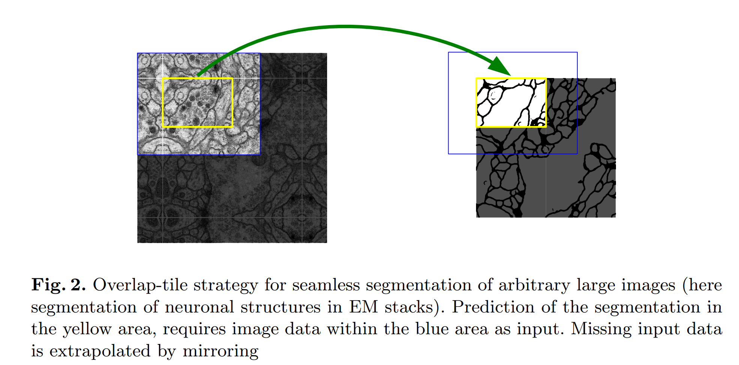
3. Deep Learning Nets
U-Net: Convolutional Networks for Biomedical Image Segmentation

Slide 20
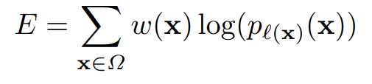
3. Deep Learning Nets
U-Net: Convolutional Networks for Biomedical Image Segmentation
pk(x) ≈ 1 for the k that has the maximum activation ak(x) and pk(x) ≈ 0 for all other k.

Slide 21
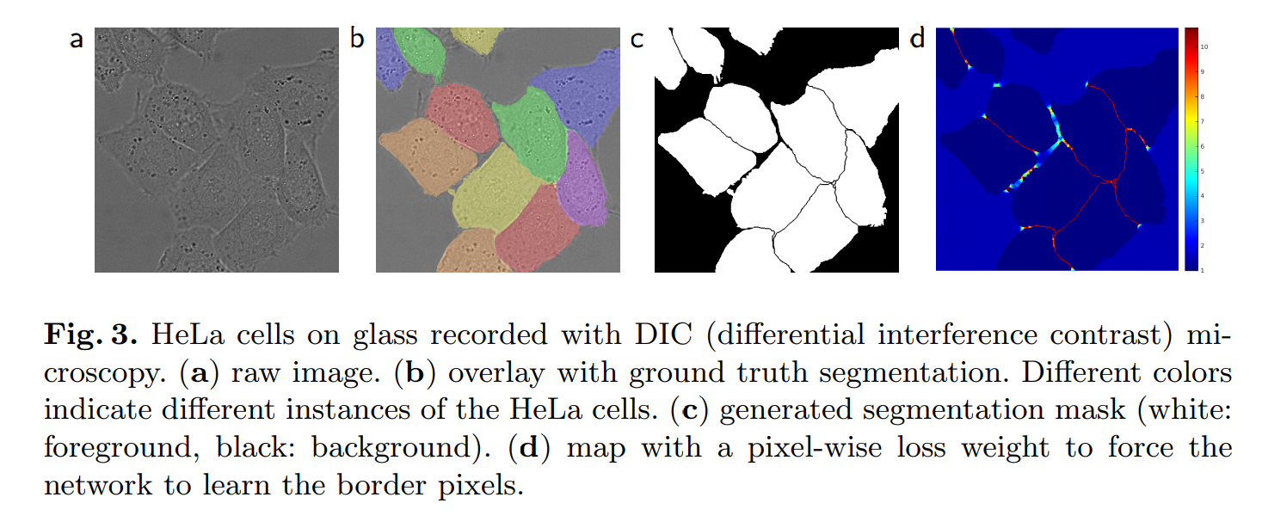
3. Deep Learning Nets
U-Net: Convolutional Networks for Biomedical Image Segmentation

Slide 22
3. Deep Learning Nets
U-Net: Convolutional Networks for Biomedical Image Segmentation
Data augmentation is essential to teach the network the desired invariance and robustness properties, when only few training samples are available. Especially random elastic deformations of the training samples seem to be the key concept to train a segmentation network with very few annotated images. We generate smooth deformations using random displacement vectors on a coarse 3 by 3 grid. The displacements are sampled from a Gaussian distribution with 10 pixels standard deviation.

Slide 23
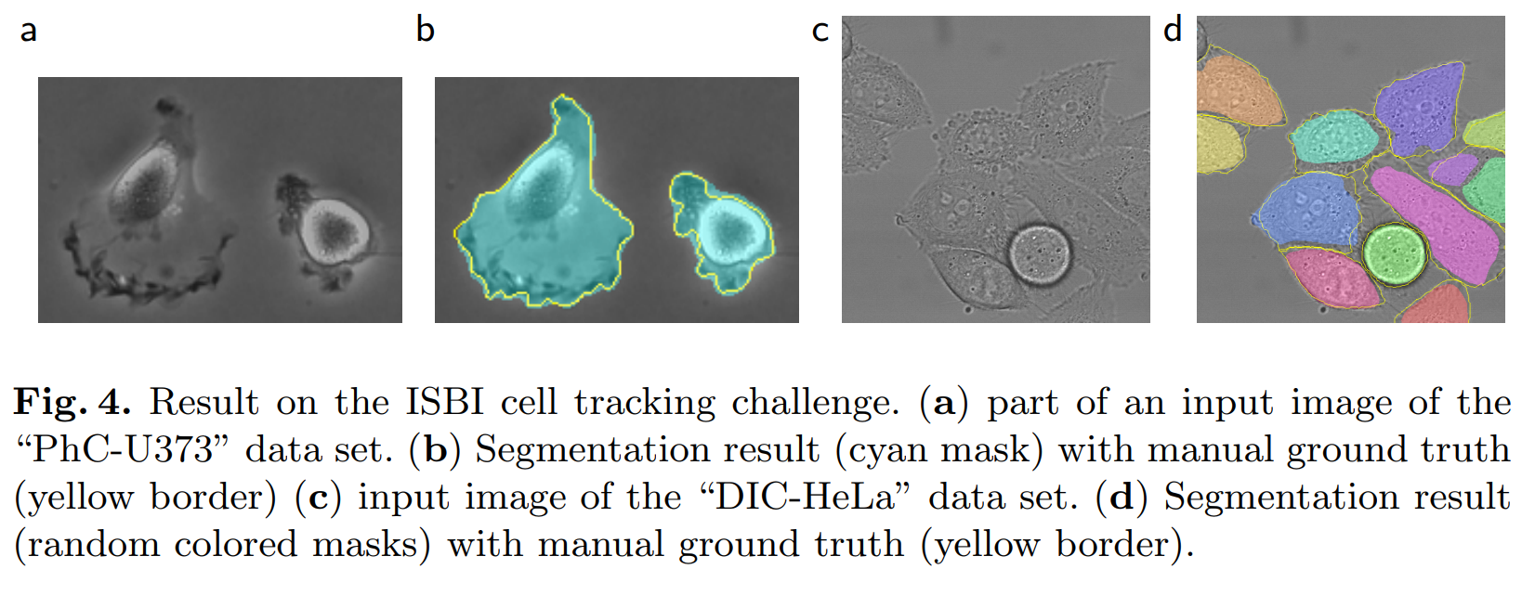
3. Deep Learning Nets
U-Net: Convolutional Networks for Biomedical Image Segmentation

Slide 24
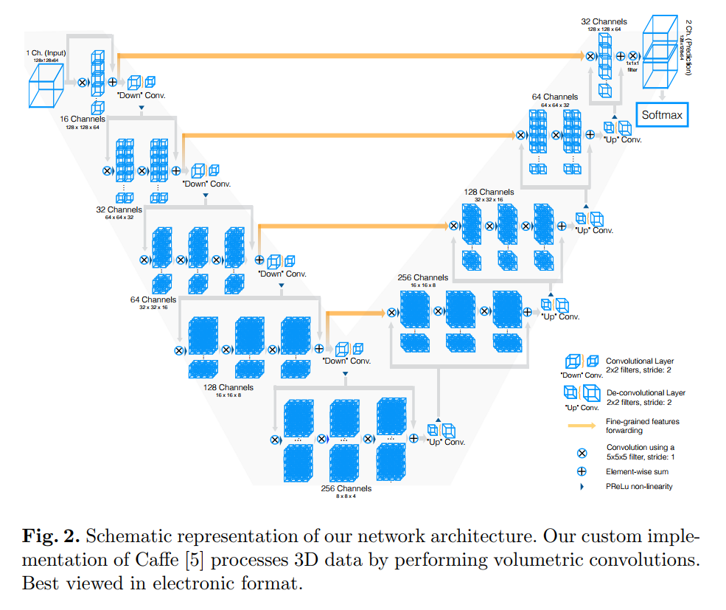
3. Deep Learning Nets
V-Net: Fully Convolutional Neural Networks for Volumetric Medical Image Segmentation

Slide 25
3. Deep Learning Nets
Deep learning for MRI-CT synthesis for radiotherapy
perfectly registered CT-MR pairs
Memory issue for training of a standard 3D deep network
Multi-view Deep Convolutional Neural Networks
Effective cost function for misalignments
Multi-view combination for memory efficiency without losing 3D context

Slide 26

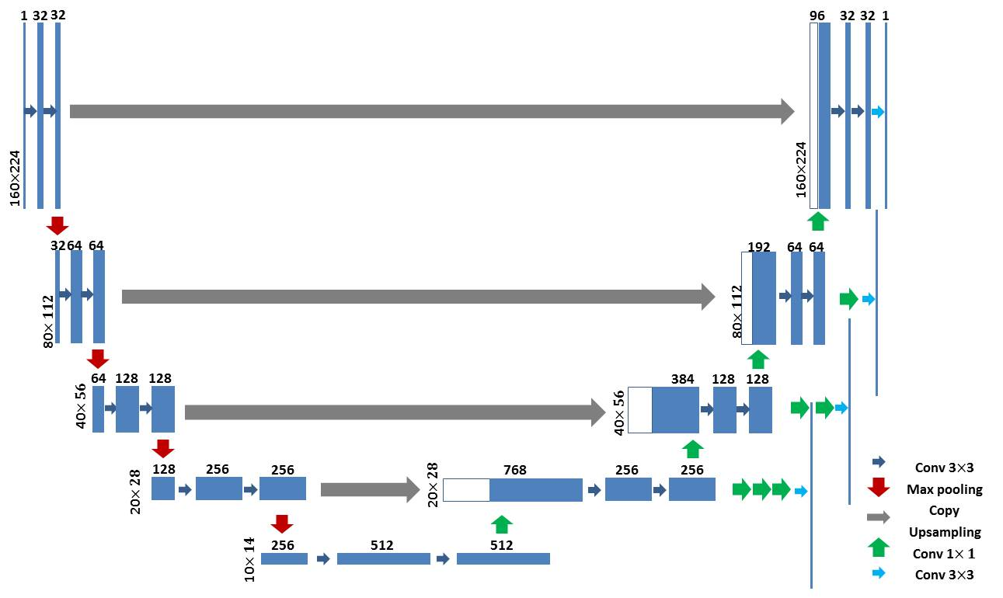
3. Deep Learning Nets
1). Unet based structure:
U-Net: Convolutional Networks for Biomedical Image Segmentation
U-Net: Our modified version

Slide 27
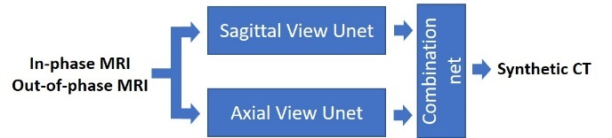
3. Deep Learning Nets

Slide 28
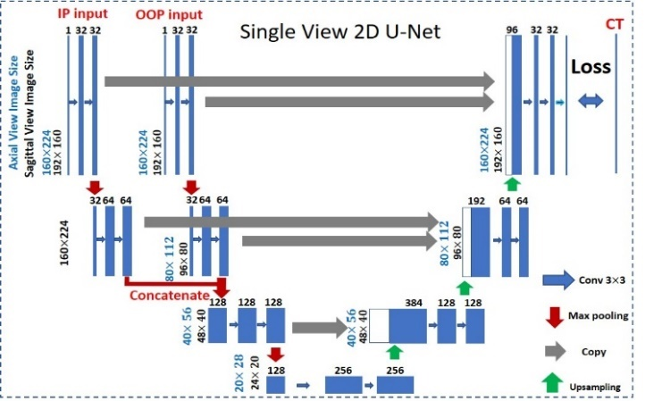
3. Deep Learning Nets

Slide 29
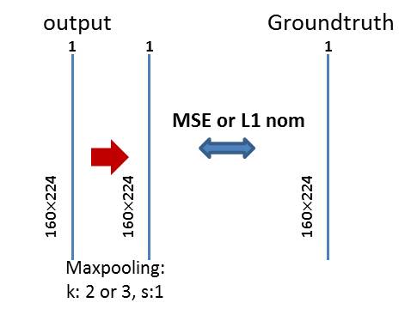
3. Deep Learning Nets
Misalignment between Ground Truth and Inputs -- Max Pooled loss:
1). Maxpooling before calculating actual loss

Slide 30
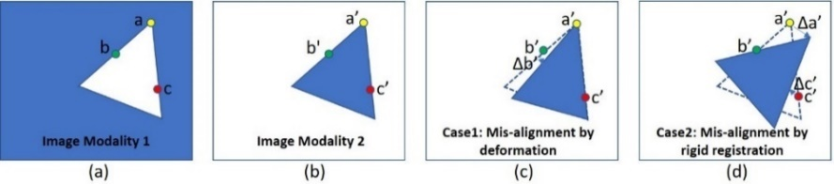
3. Deep Learning Nets
Misalignment between Ground Truth and Inputs -- Max Pooled loss:
A schematic explanation of the impact of mis-registration to intensity transformation. (a) Image1 (Modality 1), (b) A perfectly registered Image2 (Modality 2), (c) Image 2 with rigid mis-alignment, (d) Image 2 with non-rigid mis-alignment. Triangles in (a)-(d) represent the same object. Dashed lines in (c) and (d) denote the locations of the perfectly registered Image2.

Slide 31
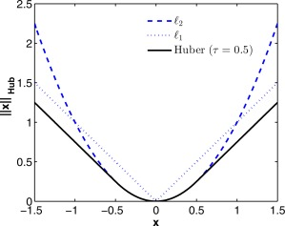
3. Deep Learning Nets
Misalignment between Ground Truth and Inputs -- Max Pooled loss:
2). using L1 distance rather than L2 as L1 encourages less blurring (Image-to-Image Translation with Conditional Adversarial Networks, Phillip Isola, et al, 2016)

Slide 32
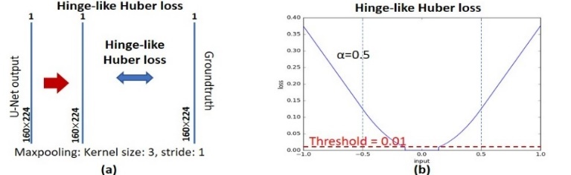
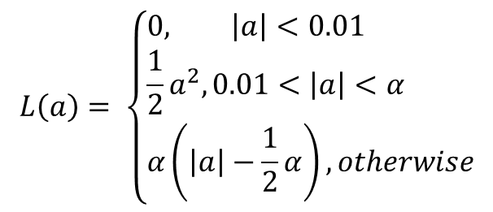
3. Deep Learning Nets
Final loss: Maxpooling Hinge-like Huber loss
$$L\left(a\right)= \left\{\begin{aligned}&0, \left|a\right|<0.01 \\ &\frac{1}{2}a^{2}, 0.01<\left|a\right|<α \\ &α\left(\left|a\right|−\frac{1}{2}α\right), otherwise\end{aligned}\right.$$

Slide 33
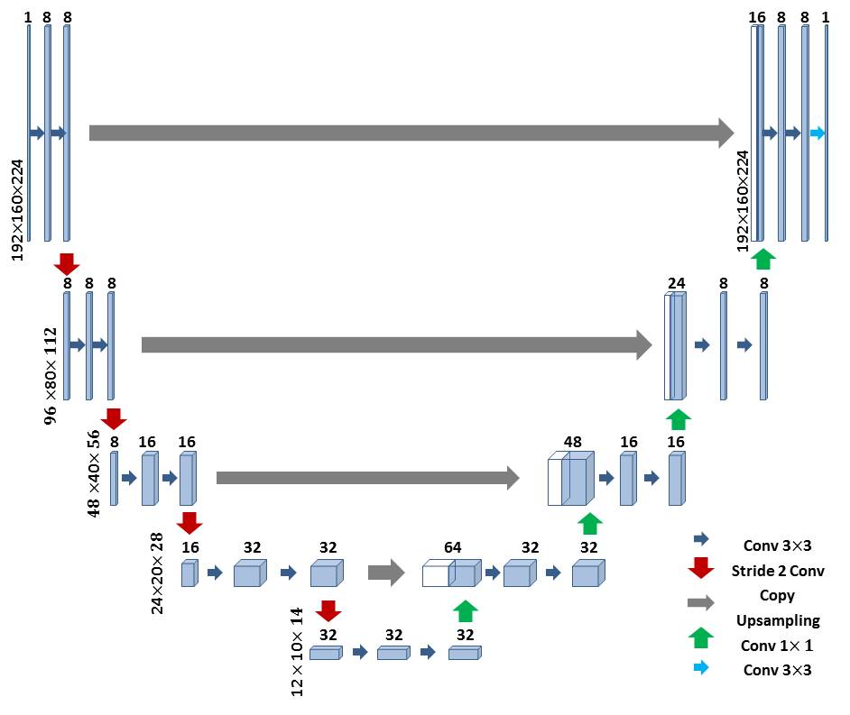
3. Deep Learning Nets
3D models (whole volume in)

Slide 34
3. Deep Learning Nets 2.5D: 2D at different views ➔ combine
Axial view: good but with serious stitching blurs
Sagittal view: overall good
Coronal view: very bad

Slide 35
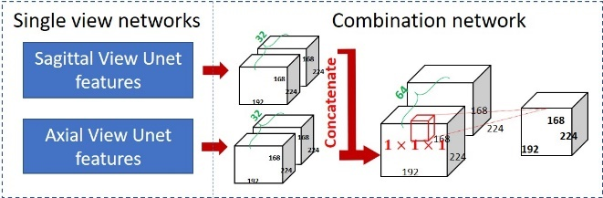
3. Deep Learning Nets 2.5D: 2D at different views ➔ combine
Combine:

Slide 36
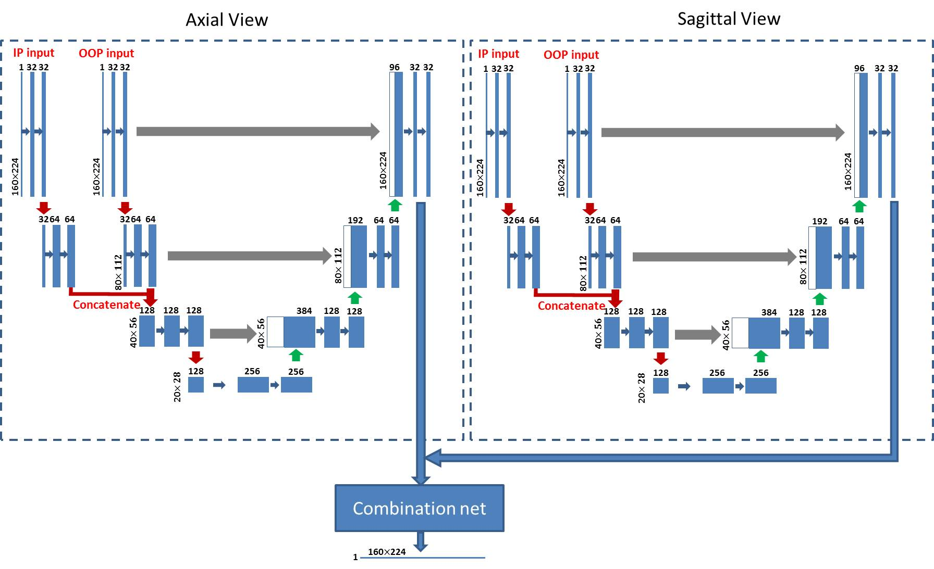
Summary
Multi-channel Multi-view net with hinge-like smL1 loss

Slide 37


